Slide 1
Pneumonia X Rays Using Neural Networks to Identify Pneumonia in Chest X Rays
Edward De Jesus

Slide 2
About 50,000 people die from pneumonia each year in the United States.
Centers for Desea Contra and Prevetion (CDC)

Slide 3

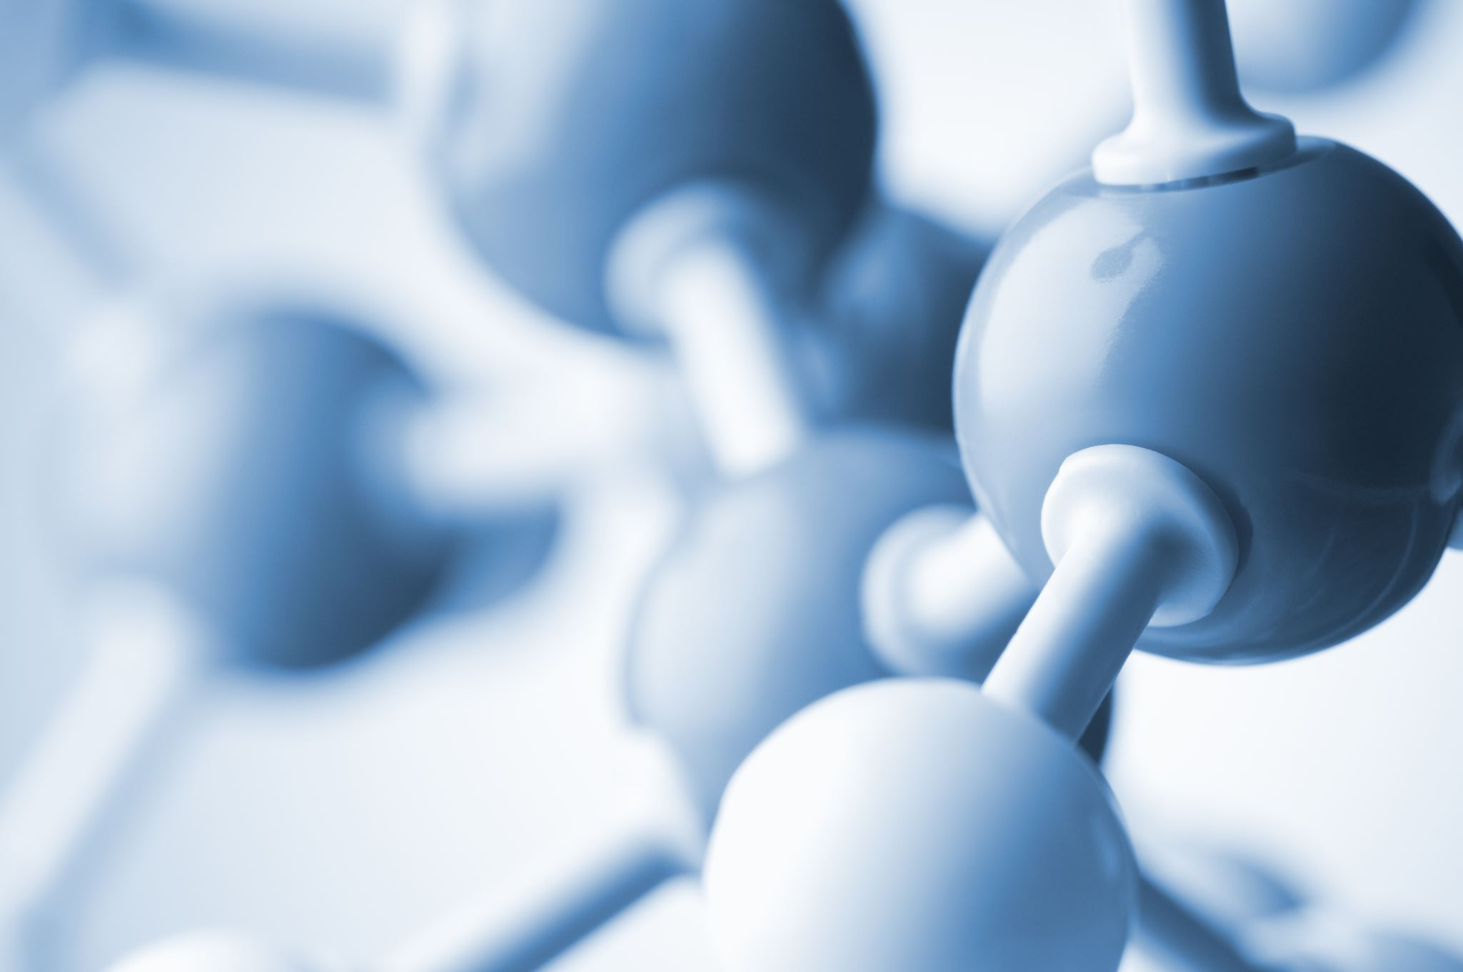


Agenda
Pneumonia overview
Pneumonia diagnosis
Diagnosis using neural networks
Results

Slide 4
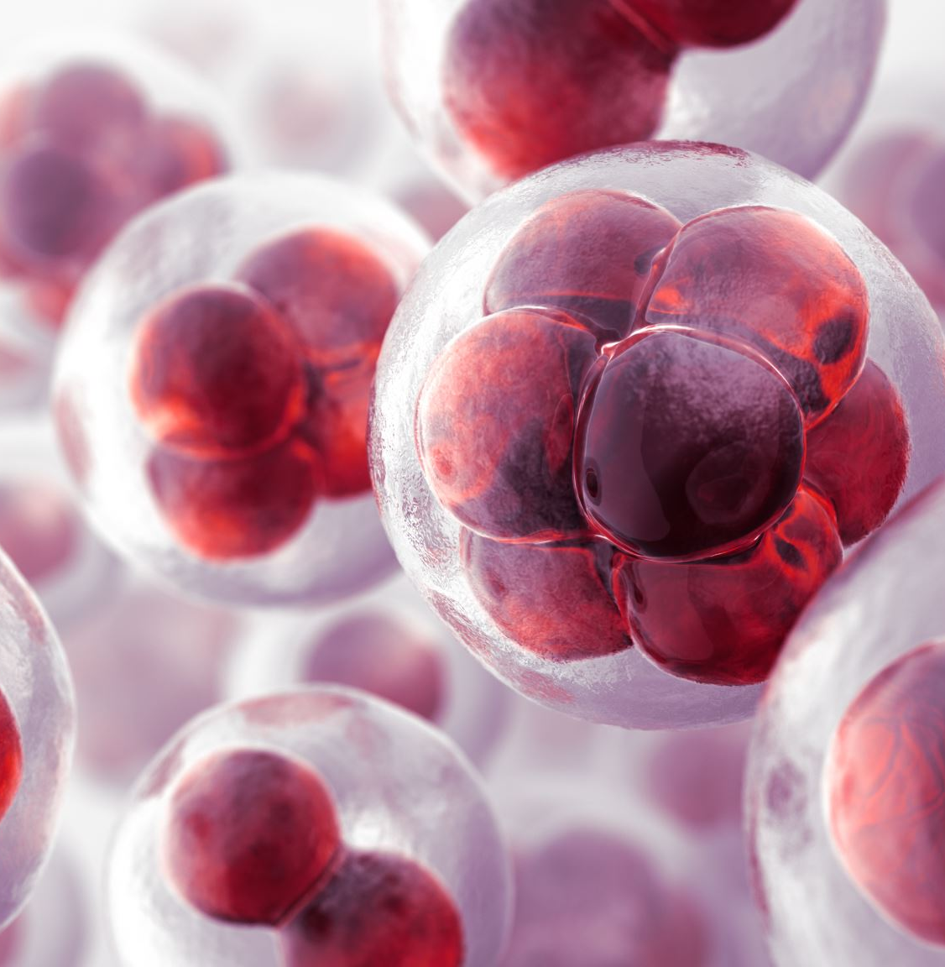

Topic one
What is pneumonia?

Slide 5
What is pneumonia?
Infection in Lungs caused by microbes.
Inflammation that causes lungs to fill up with fluids.
About 50,000 people die from pneumonia each year in the US.
Mortality rate up to 30% for severe cases.

Slide 6
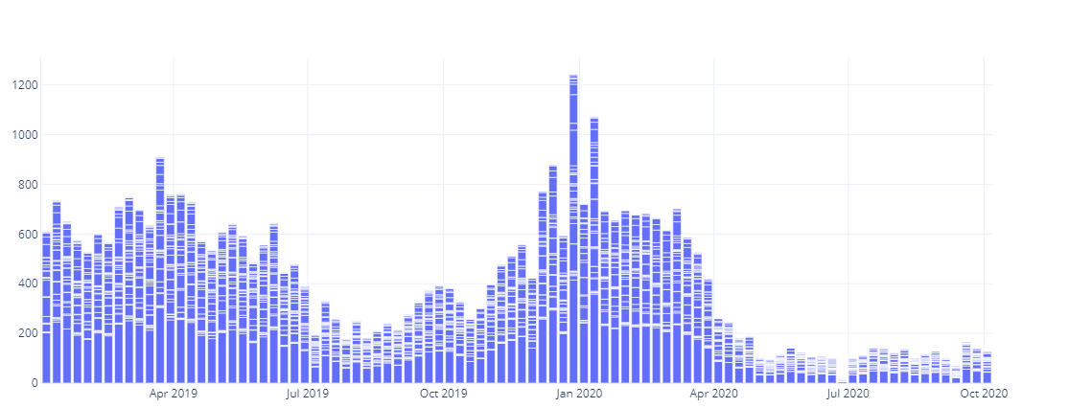
Count
Count in the US
Source: CDC

Slide 7
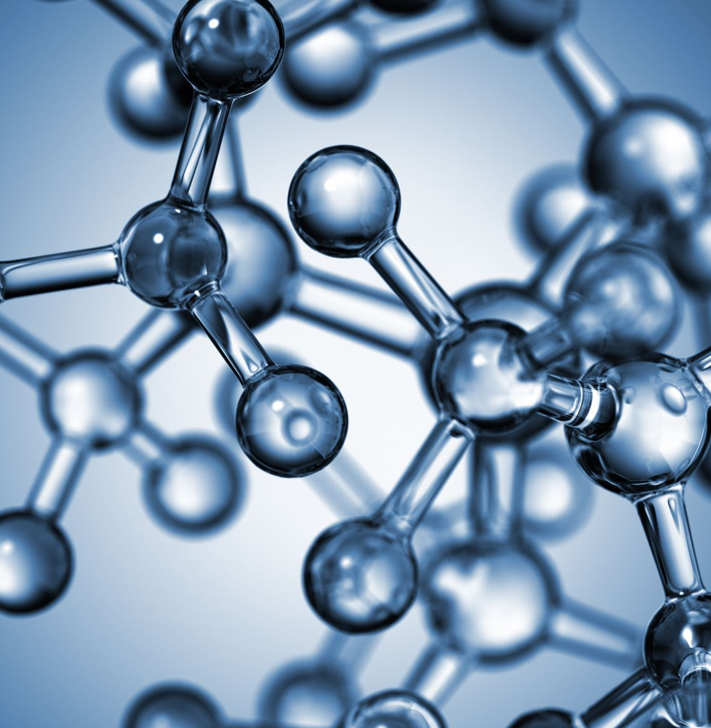
Topic two
Pneumonia diagnosis

Slide 8
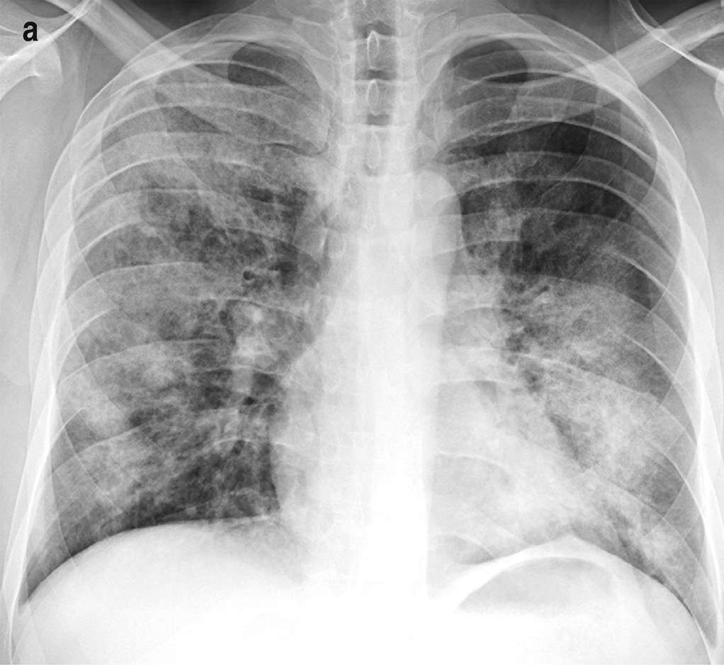
Bronchopneumonia
Characteristics
Patchy areas
Spreads throughout lungs

Slide 9
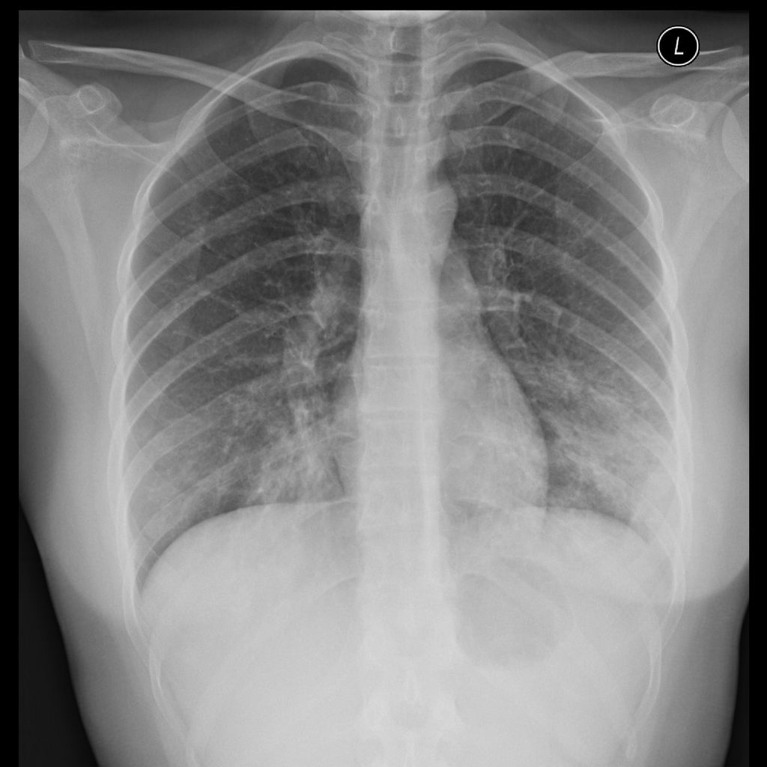
Atypical pneumonia
Characteristics
Spreads throughout lungs
Concentrates in the perihilar region of the lungs

Slide 10
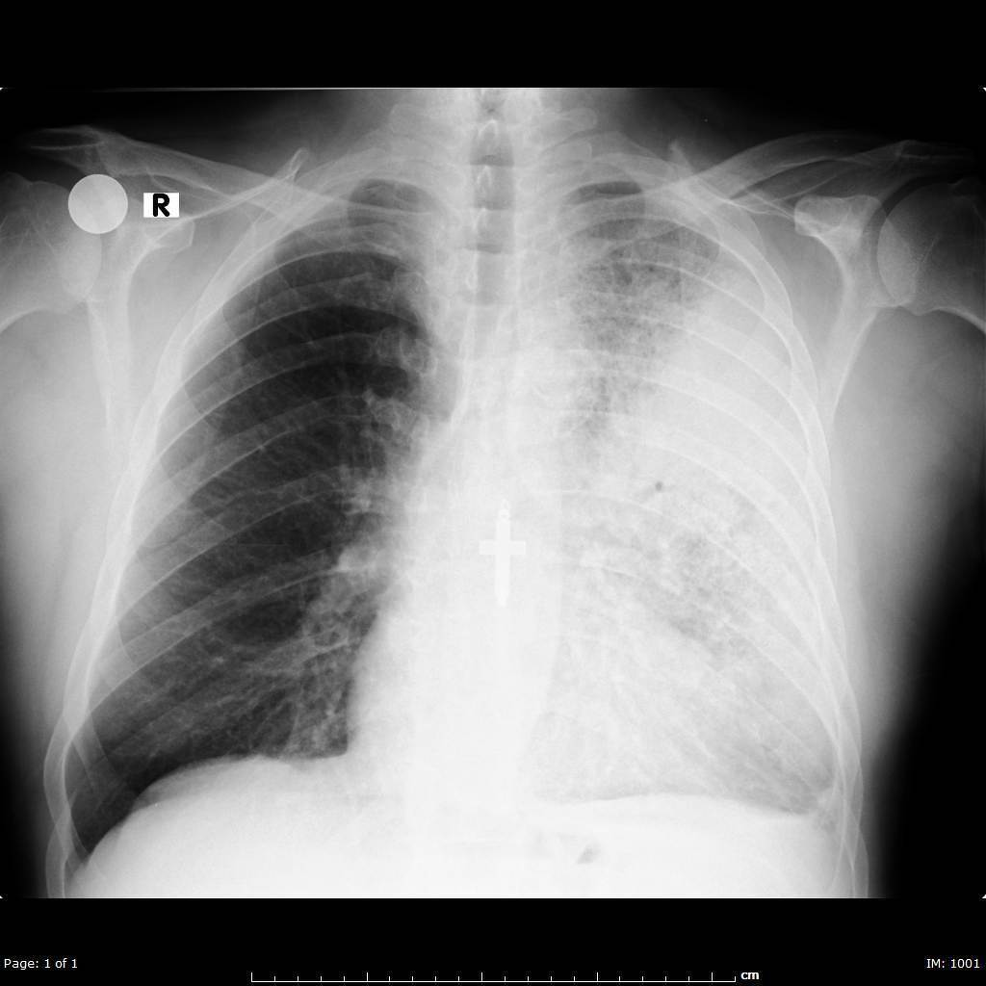
Lobar pneumonia
Characteristics
Fluid localizes to single lobe
Concentrates in a region of the lungs

Slide 11


Topic Three
Machine learning Pneumonia diagnosis

Slide 12
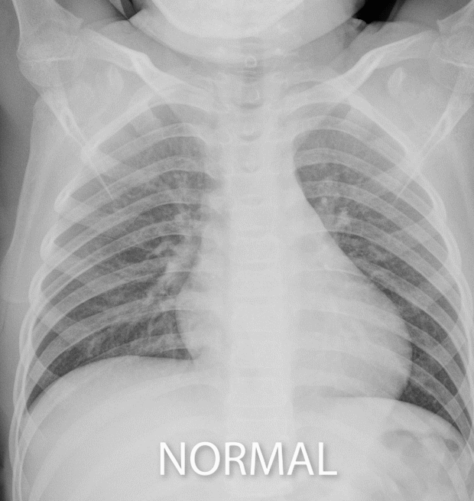
Chest X Rays
Identifying pneumonia

Slide 13
Process
Preprocessing
Imported and scaled training, validation and testing batches of x ray images from Kaggle.
Modeling
Created several convolutional models with different hidden neurons and layers.
Training
Trained the different models on the training batch.
Evaluating
Evaluated the model on the validation and test batches using the Adam optimizer, binary cross-entropy loss function, and the accuracy metric. I also evaluate the models using the recall metric.
Tunning
Experimented with different numbers of hidden neurons and layers and compare results.

Slide 14
Results
 | Test Loss | Test Accuracy | F1 Score | Recall
NN Model 1 | 0.586 | 80% | 0.828 | 0.992
NN Model 2 | 0.753 | 79% | 0.832 | 0.992
NN Model 3 | 0.513 | 83% | 0.868 | 0.969

Slide 15


Thank you
Edward De Jesus
edejesus196@gmail.com
https://github.com/edejesus196

